Slide 1
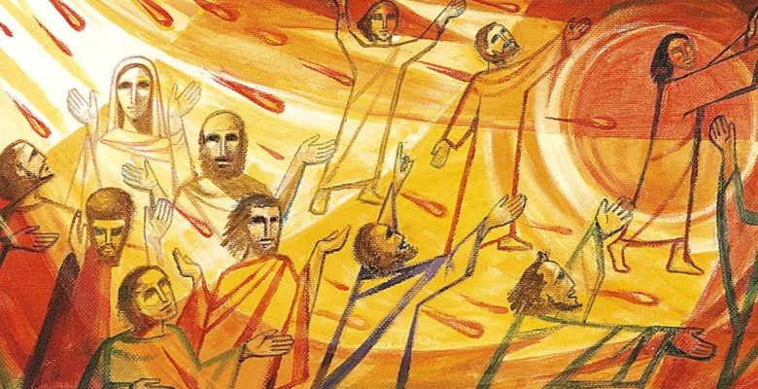
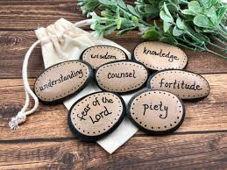
Year 3 Topic 7: Energy
Pentecost: Gifts of the Holy Spirit
Big Questions
What is the purpose of energy….can it be used for good?
Key Scripture
1 Corinthians 12:4-6
There are different kinds of spiritual gifts, but the same Spirit gives them. There are different ways of serving, but the same Lord is served.
Learn and Grow Together in Christ
What I should know already
Pentecost; spreading the Gospel message through the gifts of the Holy Spirit
Key Vocabulary
Ascension | A special holy day when Christians remember Jesus going back to his father in heaven.
Pentecost | A special holy day when Christians remember when Jesus sent the Holy Spirit to the Apostles.
Holy Spirit | The Holy Spirit is God, as is the father, and as is the Son. Nobody has seen the Holy Spirit, but we can see the works of the Holy Spirit through the joy, courage and strength that he gives.
Gifts of the Holy Spirit | The gifts of the Holy Spirit help people to lead good lives and make use of the gifts they have; wisdom, understanding, counsel, fortitude, knowledge, piety, awe and wonder.
Energy | The power to make something work or to be active
Other vocabulary | Fire, warmth, wind, power
Sticky Knowledge
The story of the Ascension
The coming of the Holy Spirit
(power and energy)
How the Church celebrates Pentecost
What symbols are used to depict the Holy Spirit
-
How the apostles changed after the coming of the Holy Spirit – how he energized them
How Christians can use the gifts of the Holy Spirit to help others
The gifts of the
Holy Spirit

