Slide 1

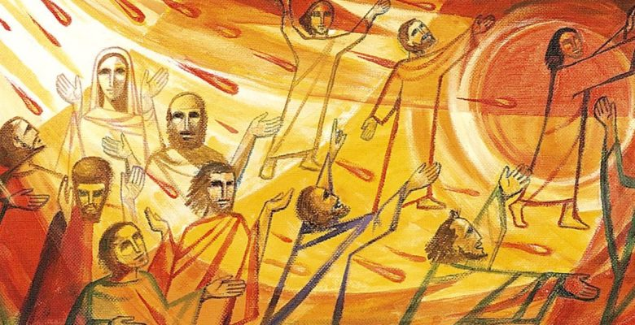
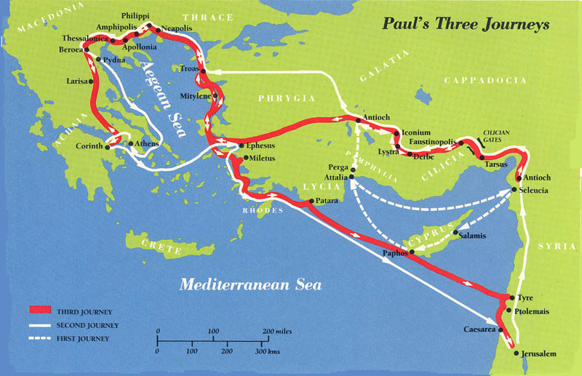

Year 4 Topic 7 New Life
Pentecost: To hear and live the Easter message
Big Questions
What is so important about new life?
Can good news bring new life?
Learn and Grow Together in Christ
Key Scripture
Acts 2:1-4
When the day of Pentecost had come they were all together is one place…All of them were filled with the Holy Spirit and began to speak in other languages, as the Spirit gave them ability.
What I should know already
The wonder and power of the Holy Spirit.
Key Vocabulary
Good News | In the Bible, the Good News is the news of Jesus’ resurrection.
Resurrection | Resurrection means: someone who really died, gets new life from God. Christians celebrate the resurrection of Jesus at Easter.
Pentecost | A special holy day when Christians remember when Jesus sent the Holy Spirit to the Apostles. Pentecost is a Greek word meaning ‘the fiftieth day’. It is linked to a Jewish celebration ‘Shavu’ot’ – the Festival of Weeks
Holy Spirit | The Holy Spirit is God, as is the father, and as is the Son. Nobody has seen the Holy Spirit, but we can see the works of the Holy Spirit through the joy, courage and strength that he gives.
Other vocabulary | Life, fellowship
Sticky Knowledge
The story of Pentecost and how the Holy Spirit gave courage to Peter and
John to bear witness
to Jesus
The story of Paul and how he spread the good news
How the Ethiopian received the new
life of Jesus
How the Holy Spirit gave Paul the new life in Jesus
How Christians can continue to spread
the Good News

