Slide 1
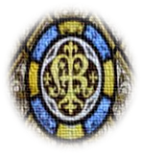
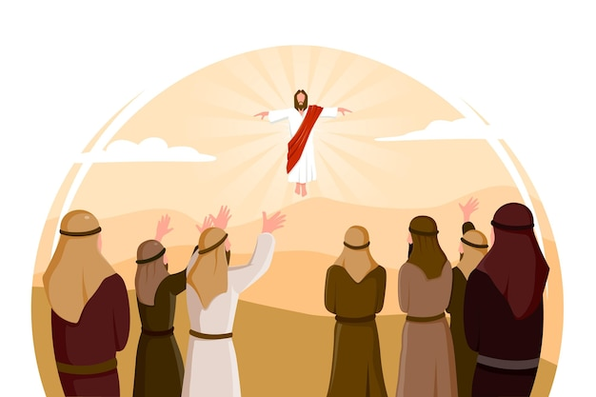
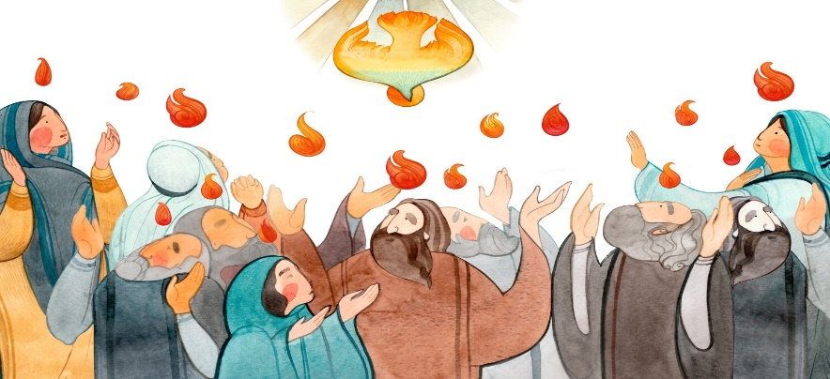
Year 1 Topic 7: Holidays and Holydays
Pentecost: The feast of the Holy Spirit
Big Questions
Do we need holidays and holy days?
How does the Holy Spirit help and guide us in our lives?
Scripture
John 14:26
The Helper, the Holy Spirit whom the Father will send in my name will teach you everything and make you remember all that I have told you.
Learn and Grow Together in Christ
What I should know already
Pentecost; the celebration of the Good News of Jesus.
Key Vocabulary
Holyday | Some days of the year are ‘holy days’ when we celebrate special times in the Church year.
Apostles | Jesus appointed 12 apostles from his disciples (friends) who followed him. The word apostle comes from Greek and means ‘envoy’.
Pentecost | A special holy day when Christians remember when Jesus sent the Holy Spirit to the Apostles.
Resurrection | Resurrection means: someone who really died gets new life from God. Christians celebrate the resurrection of Jesus at Easter.
Alleluia | Alleluia is a special word we say that means ‘Praise the Lord’.
Other vocabulary | Holiday, help, guide, promise
Sticky Knowledge
What a holyday is.
Ascension Day and Pentecost are Holydays
Pentecost and the promise Jesus made to his friends
Pentecost: the birth of the Church
The Good News of Jesus

