Slide 1
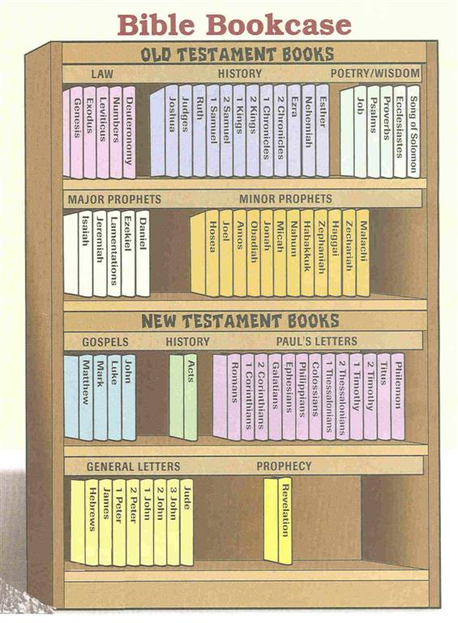
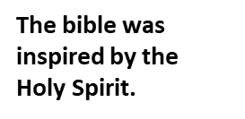
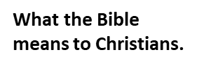
Year 6 Topic 4 Sources
The Bible- The special book for the Church
Big Questions
Are books enriching?
The wonder of books and how they take a person beyond themselves.
Learn and Grow Together in Christ
What I should know already
The Bible is the Word of God and was written by many people over many years.
The Church family gather to hear the Word of God at Mass.
Key Vocabulary
Bible and Sacred Scripture | Bible comes from the Greek word ‘Biblos’ which means ‘book’. The Bible is the most important book for Christians because it tells us how much God loves us and through the Sacred Scriptures in the Bible God speaks directly to us. When we read the Bible, God is speaking directly to us. The Bible has two parts, the Old Testament and the New Testament.
New Testament | The New Testament is the second part of the Bible and tells us all about Jesus Christ and the start of the early Christian church. It includes the four Gospels.
Old Testament | The Old Testament is the first part of the Bible before Jesus was born. It starts with creation and tells us how people got to know God and ends with the coming of a new heaven and earth.
Genre | A style or category of art, music or literature. The types of genre in the Bible include law, narrative, psalms (poetry), wisdom, prophecy, gospels, parables, letters.
Key Scripture
Romans 15:4-6
The example of Christ
Sticky Knowledge
The care and reverence with which the Word of God is treated.
Some of the books and their genres.
The different parts of the Bible; The Old Testament, Hebrew Scripture, Gospels, Acts, Letters and Revelation.

