Slide 1
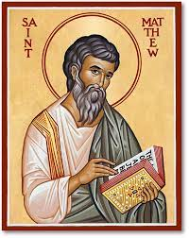
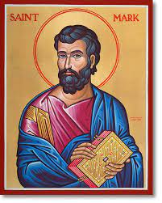
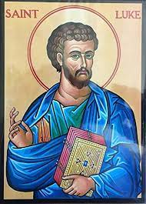
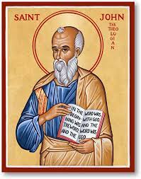
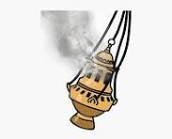
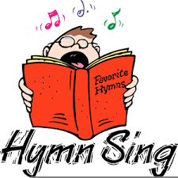
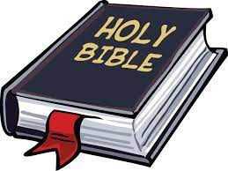
Year 2 Topic 4 Books
The books used in the Church
Scripture
Matthew 3:13-17
Jesus baptized by John
Big Questions
Why do we need books?
What is special about the Bible and why is it important to us?
Learn and Grow Together in Christ
What I should know already
The Church family gather at Mass on Sunday.
We hear the Bible read at Church.
We listen to stories from the Bible in our Prayer and Worship
Pope Francis
“What would happen if we treated the Bible like we do our mobile phones?”
Key Vocabulary
Bible and Sacred Scripture | Bible comes from the Greek word ‘Biblos’ which means ‘book’. The Bible is the most important book for Christians because it tells us how much God loves us and through the Sacred Scriptures in the Bible God speaks directly to us. When we read the Bible, God is speaking directly to us. The Bible has two parts, the Old Testament and the New Testament.
Old Testament | The Old Testament is the first part of the Bible before Jesus was born. It starts with creation and tells us how people got to know God and ends with the coming of a new heaven and earth.
New Testament | The New Testament is the second part of the Bible and tells us all about Jesus Christ and the start of the early Christian church. It includes the four Gospels.
Gospels | The story of Jesus Christ and his teachings told by the four Gospel writers, Matthew, Mark, Luke and John.
Respect | Caring for something or someone.
Sticky Knowledge
The Bible is a special book and there are four Gospels.
The responses we say and what they mean to us.
The variety of books used during the Mass by the parish family.
The way the Gospel is reverenced at Mass.
The story of the Baptism of Jesus.
lectern
thurrible

