Slide 1
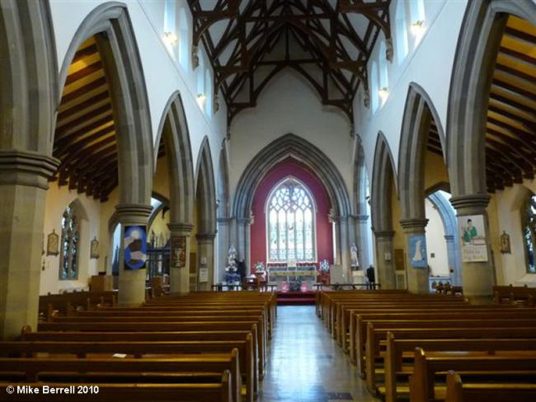
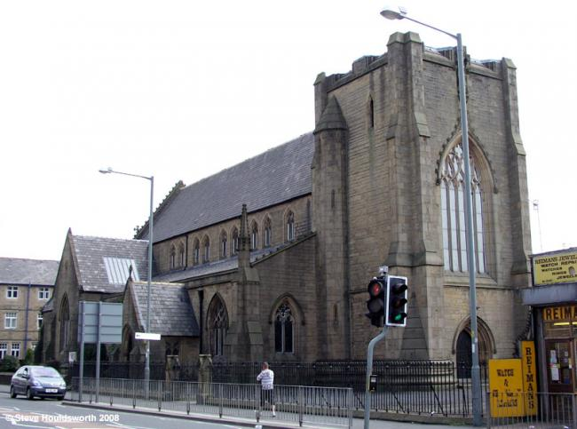
Year 4 Topic 4 Community
Life in the local Christian Community: ministries in the parish
Big Questions
What helps to make a community?
Why do people give up their time to help others in the community?
Learn and Grow Together in Christ
Pope Francis
I really like football…Do you know why? Because I can see how a team makes one unit.
Key Scripture
Romans 12:8-11
Christian life: be concerned for others
Mark 3:13-19
The twelve apostles
Acts 6:2-13, 7:57-60
The choosing of assistants
What I should know already
Jesus chose 12 Apostles to help him?
The priest leads the community in Church.
There are many people who help in Church.
Key Vocabulary
Commitment | Being dedicated (sticking to) a cause or activity.
Parish | A community of the Church in a particular place, led by a priest. St. Mary’s is in the parish of the Good Samaritan.
Laity | Members of a parish who are not ordained – the ordinary people.
Ministry | The work of the priest. Jesus also had his ministry when he was on earth.
Extraordinary Ministers | A member of the laity (not a priest or deacon) who has been given special permission to distribute the Holy Eucharist.
Deanery/ Pastoral areas | Several parishes form a deanery, sometimes called a ‘pastoral area’. This unit is led by one of the priests of the deanery who has the title of ‘Dean’.
Service | Helping or doing work for someone.
Funeral rites | Practice followed by the Catholic church at a funeral service.
Sticky Knowledge
What a community is.
What it is that makes up a parish community and pastoral area.
Some of the roles and ministries within the parish community
Some of the advice and messages within Scripture used about serving the community
How the parish community celebrates together and supports one another.

