Slide 1
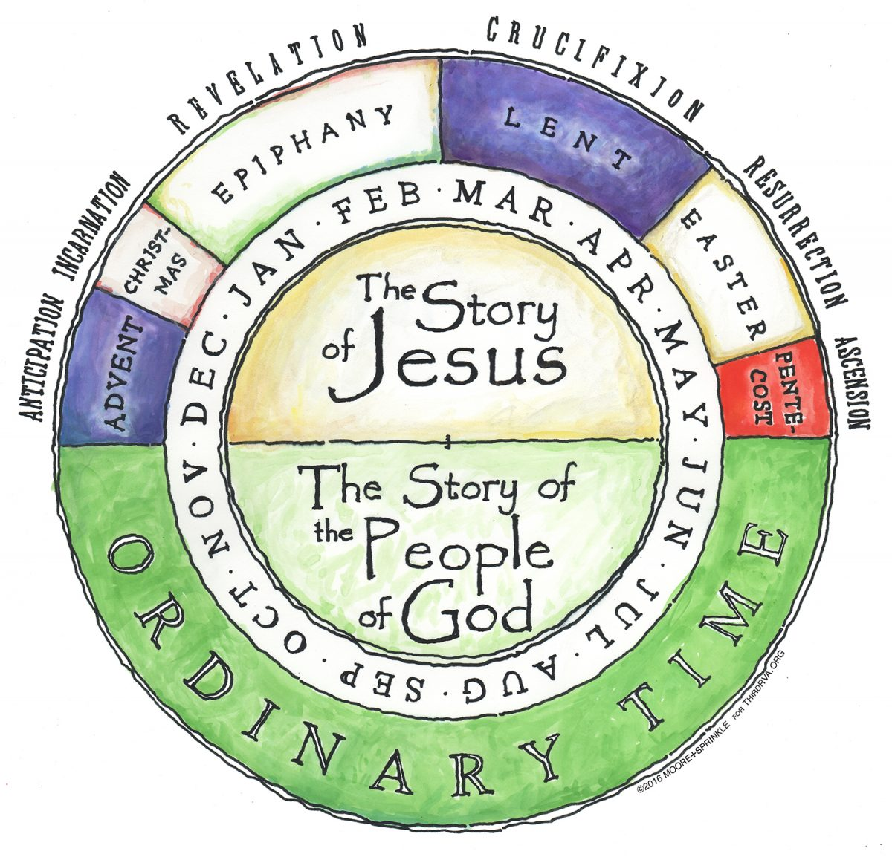
Year 3 Topic 4 Journeys
Christian family’s journey with Jesus
Big Questions
Is life a journey?
How can we help one another on life’s journey?
Key Scripture
Psalm 84
Psalm 118:19-20
Psalm 122:1-9
Learn and Grow Together in Christ
What I should know already
There are special times in the Church’s calendar.
The Church uses different colours for each of the special times in the calendar.
Key Vocabulary
Calendar/ Liturgical Year/Seasons | With the ‘Church year’, the Church repeats the core of the life of Jesus in an annual rhythm, e.g. the Advent season prepares us for the arrival of Christ; Lent teaches us to repent, so that we can be transformed by Easter. The seasons of the Church = Ordinary, Advent, Christmas, Lent, Easter, Pentecost
Journey | The process of personal change and development through a persons life- with all its joys and challenges. Also – to travel from one place to another.
Ordinary Time | The time in the Church calendar that is not a feast day, celebration or preparation for a celebration, such as Advent or Lent. During Ordinary Time the priest will wear green garments.
Feast Days | Feast days are special days when we remember saints who lead us to Jesus.
Our Lady | Mary, the mother of Jesus. She is our mother too.
Sticky Knowledge
The structure of the Liturgical Year, its special times and seasons.
The colour used by the Church at different seasons.
What Ordinary Time is.
What liturgy means.
The Mysteries of the Rosary show the journey of Jesus and Mary’s life.
The cycle of readings for Sundays.
Some of the feasts of Our Lady.

