Slide 1
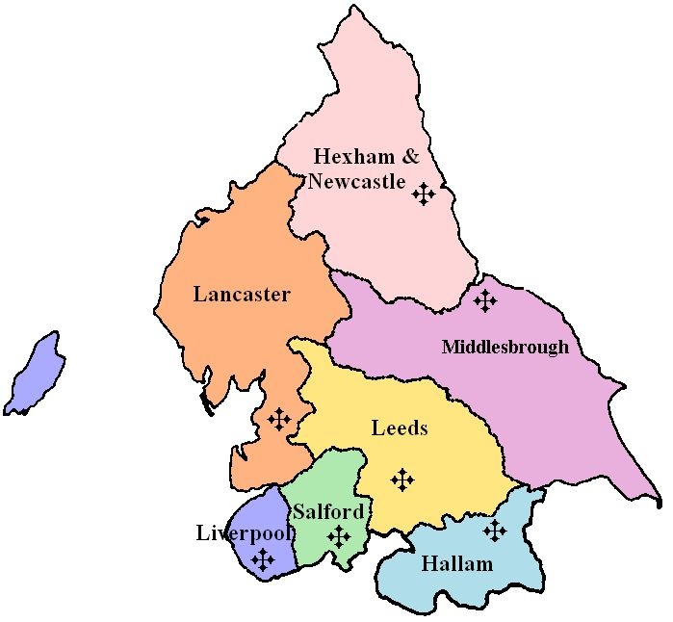
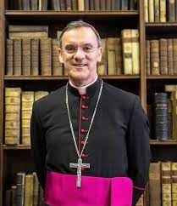
Year 5 Topic 4 Mission
Continuing Jesus’ Mission in the Diocese (ecumenism)
Big Questions
Do we all have a mission in life?
What inspires people in their mission?
Learn and Grow Together in Christ
What I should know already
Jesus chose 12 Apostles to help him?
The priest leads the community in church.
We are called to be loving members of the Church reaching out to the community.
Key Scripture
Luke 4:14-22 Jesus begins his ministry
Luke 5:27-32 Jesus calls Levi
Luke 8:1-3 Women accompanying Jesus
Isaiah 61:1-2, 10-11:
John 17:11-12, 20-23
1 Corinthians 12:12-17, 21, 27
Key Vocabulary
Mission | The Christian mission is to spread the Good News of Jesus.
Bishop | The leader of the Christian community in his diocese. Bishops are appointed by the Pope and are successors of the Apostles. The current Bishop of Salford is Bishop John Arnold.
Diocese | An area under the care of a Bishop. St. Mary’s is in the Diocese of Salford.
Ecumenism | The work for unity between different Christian Churches.
Cathedral | A place of Christian worship – the main church of a Diocese and often associated with the Bishop.
Apostle | The word ‘Apostle’ comes from Greek and means “envoy”. Jesus appointed twelve apostles and they were sent out to preach the Good News.
Christian Unity | An area under the care of a Bishop. St. Mary’s in in the Diocese of Salford.
Gentile | Someone who is not Jewish.
Sticky Knowledge
Jesus started his mission reading from Isaiah.
The apostles shared Jesus’ mission and the call of Levi.
How people carry out Jesus’ mission today.
What a diocese is and its mission.
The role of the bishops as successors of the apostles in continuing Jesus’ mission.
Other Christian communities.
Jesus’ prayer for unity.

