Slide 1
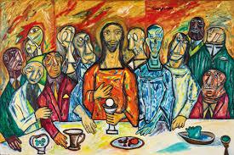
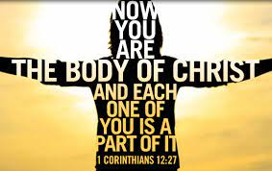
Year 6 Topic 5 Eucharist
Eucharist enables people to live in communion
Big Questions
Why are we happiest when we are united?
Learn and Grow Together in Christ
What I should know already
The Eucharist keeps the memory of Jesus’ sacrifice alive and present in a special way
Key Scripture
Romans 12:4-5
For as in one body we have many members, and not all members have the same function, so we, who are many, are one body in Christ, and individually we are members one of another.
Key Vocabulary
Eucharist | The celebration of the Eucharist is a sign of being at one with God: Father, Son and Holy Spirit, as well as being at one with each other.
Communion | Communion means ‘being at one with’. It is similar in meaning to words uch as relationship, empathy, unity, union, one with.
Community | The Eucharist calls us to strengthen our community – do we help each other, do we forgive each other?
Unity | Being united and joined together.
Sticky Knowledge
Jesus’ prayer for unity in John’s Gospel.
Eucharist challenges Christians to live in communion.
Paul’s letter explaining how we are all different, but one in Jesus Christ.
Communion is a sign of being at one.
The Communion Rite, the Our Father and its meaning.
The prayer for peace and unity within the Communion Rite.
In Holy Communion we become one with Christ and one another.

