Slide 1
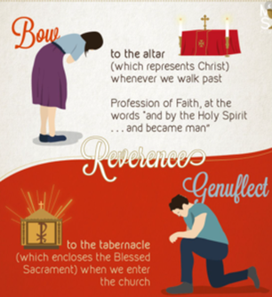
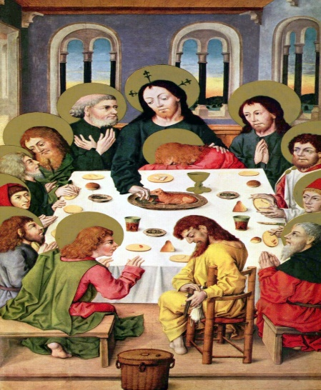
Year 5 Topic 5 Eucharist
The Eucharist; the living memorial of Jesus
Big Questions
Why do we need memories?
How can we keep memories alive?
Learn and Grow Together in Christ
What I should know already
The Eucharist challenges and enables living and growing in communion.
Key Vocabulary
Memorial sacrifice | The Eucharist is a memorial sacrifice, in that it makes present a past reality. It’s a memorial of Christ’s sacrifice on the Cross
Passover/ Pesach | An important Jewish holiday that celebrates the story of the Israelites escape from slavery in Egypt.
Liturgy of the Eucharist | Second part of the Eucharistic celebration where the gifts are prepared, the Eucharistic prayer expresses thanksgiving and Communion is shared.
Eucharist Prayer | In the Eucharistic Prayer the priest calls to mind the memory of Jesus’ words and actions at the Last Supper.
Consecration | Consecration means ‘made holy’. During the Liturgy of the Eucharist the holy spirit turns the host and the wine into the body and blood of Christ.
Adoration | Adoration is respect, reverence, strong admiration, or love in a certain person, place, or thing
Acclamation | After consecration, we say the Mystery of Faith –we believe that Jesus is truly present, but we can’t fully explain or understand it. We say one of three acclamations.
Other vocabulary | Memories, significant, memorial, sacrifice, genuflect
About sacrifice in daily life.
Sticky Knowledge
What remembering the Passover means to Jewish people.
Key Scripture
1 Corinthians 11:23-26
For I received from the Lord what I also handed on to you, that the Lord Jesus on the night he was betrayed took a loaf of bread, and when he had given thanks, he broke it and said, ‘this is my body that is for you. Do this remembrance of me…….’
Some understanding of the words of consecration.
Eucharist is a memorial of Jesus’ sacrifice
The Last Supper, when Jesus gave his disciples his body and blood in the form of bread and wine as his memorial.
Something about the proclamation of the mystery of faith.
Eucharistic Prayer II which remembers and thanks Jesus.
The Last Supper is called to mind and made present and real for Christians in the Eucharist.

