Slide 1
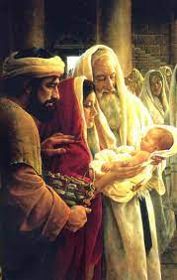
Year 1 Topic 4 Special People
People in the parish family
Big Questions
What makes a person special?
Who are the special people in our families and parish family and why?
Learn and Grow Together in Christ
What I should know already
God knows me and loves me
God knows my name
Scripture
Luke 2:23-40:
Jesus is presented at the Temple
Luke 2:41-52
I must be in my Father’s house
Key Vocabulary
Welcomers | People who welcome the church family to Mass.
Holy | Special to God.
Presentation | Mary and Joseph took Jesus to the temple when he was a baby- as was the Jewish custom.
Church | The church is the community of all those who belong to Christ. It comes from the Greek word Kyrios – belonging to the Lord.
Community | A group of people who come together to do a special task.
Temples | Places of worship for Jewish people.
Altar servers | People who help the priest at Mass.
Collectors | People who gather in donations to help the church during Mass.
Readers | People who read the Readings and Psalm at Mass.
Sticky Knowledge
There are people who do special jobs at Mass when the parish family gathers.
Listening to the gospel stories of Jesus at Mass.
Jesus is the special person for the parish family
Some of the ways in which these people help.
The story of the Presentation of Jesus in the Temple.
Leaving Mass to love and serve each other.
The finding of Jesus in the Temple.

