Slide 1
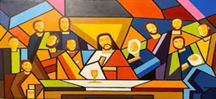
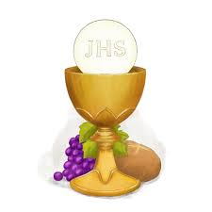
Year 1 Topic 5 Eucharist
Mass; Jesus’ special meal
Big Questions
What makes some meals special?
Learn and Grow Together in Christ
What I should know already
The joy of gathering together to celebrate at Mass
Key Vocabulary
Blessing | A short prayer, usually followed with the sign of the cross asking for God’s favour on persons or objects.
Last Supper | The supper Jesus has with his disciples on the night before he died, during which he started the Eucharist
Mass | The most important celebration for Catholics where we meet God through his word and himself in Holy Communion.
Eucharist or Holy Communion | The Eucharist or Holy Communion is the meeting point where God gives himself to us as food through his Word and through himself. We receive the Body of Christ and become part of his Body – the Church. Eucharist is a Greek word that means ‘Thanksgiving’.
Offertory | Part of the Eucharistic service when bread and wine are placed on the altar.
Litany | A type of prayer in which the minister says a series of petitions to God, or calls on the help of the saints.
Other vocabulary | Family, meal, share, bread, host, wine, altar, chalice
Sticky Knowledge
Scripture
1 Corinthians 11:26
Whenever you eat this bread, and drink this cup you are proclaiming the Lord’s death until he comes.
The story of the Last Supper.
The family prayer of the Church; the Our Father.
Some parts of the Mass, the offertory and Holy Communion.
Host and chalice
How the parish family come together to celebrate and share a meal.
How it is good to say thank you for our meals.
Altar

