Slide 1
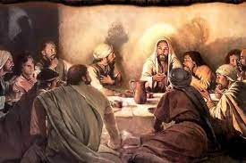
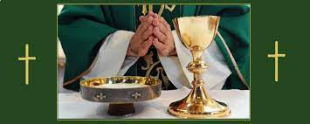
Year 2 Topic 5 Eucharist
Mass: a special time for saying thank you to God for everything, especially Jesus
Big Questions
Why should we be grateful people?
Why is it important to say thank you?
Learn and Grow Together in Christ
What I should know already
Mass as Jesus’ special meal.
Key Vocabulary
Thanksgiving | Being grateful for what we have been given. The Greek word for thanksgiving is ‘Eucharist’. Eucharist is another name for Holy Mass.
Eucharist | The Eucharist or Holy Communion is the meeting point where God gives himself to us as food. We receive the Body of Christ and become part of his Body – the Church. Eucharist is a Greek word that means ‘Thanksgiving’. We give thanks to God , most of all for the gift of Jesus, his Son.
Eucharistic Prayer | The priest takes the place of Jesus and says special prayers over the bread and wine so that they become the Body and Blood of Christ.
Other Vocabulary | Thank you, thoughtful
Sticky Knowledge
The story of the Last Supper.
Some of the Mass responses.
Why the parish family gather at Mass.
The four parts of the Mass.
Scripture
1 Corinthians 11:23-24
The Lord Jesus, on the night he was betrayed, took a piece of bread, gave thanks to God, broke it and said, ‘This is my body, which is given for you. Do this in memory of me.’
During the Eucharist, the bread and wine become the Body and Blood of Jesus Christ.
The parish family go out from Mass in peace and thanksgiving to love and serve God.

