Slide 1
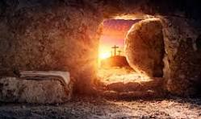
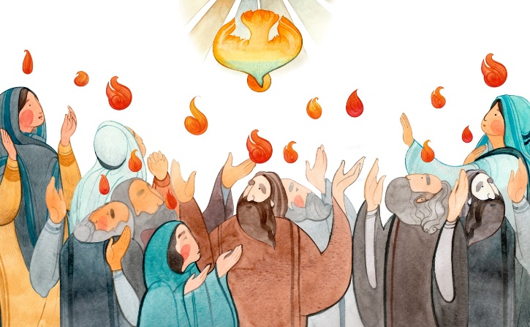
Year 2 Topic 7: Spread the Word
Pentecost: A time to spread the Good News
Big Questions
Why should we spread the Good News?
Scripture
Acts 2:32
(Peter speaking)
God raised this very Jesus from the death and we are all witnesses to this fact.
Learn and Grow Together in Christ
What I should know already
Pentecost; a holy day – the feast of the Holy Spirit
Key Vocabulary
Resurrection | Resurrection means: someone who really died, gets new life from God. Christians celebrate the resurrection of Jesus at Easter.
Ascension | A special holy day when Christians remember Jesus going back to his father in heaven.
Pentecost | A special holy day when Christians remember when Jesus sent the Holy Spirit to the Apostles.
Holy Spirit | The Holy Spirit is God, as is the father, and as is the Son. Nobody has seen the Holy Spirit, but we can see the works of the Holy Spirit through the joy, courage and strength that he gives.
Good News | The news that Jesus rose from the dead.
Blessing | A blessing is God’s favour. You bless someone by making the sign of the cross over them. The Latin word for blessing is benedicere which means ‘to speak well of’.
Witnesses | People who have seen something happen.
Other vocabulary | Message, promise, risen
Sticky Knowledge
On Easter Sunday we remember that Jesus rose from the dead
On the Feast of the Ascension the Church celebrates Jesus return to Heaven
Jesus’ promise of the Holy Spirit
What happened on the first Pentecost day
Jesus has promised
us new life
Ways of spreading the Good News about Jesus

