Slide 1
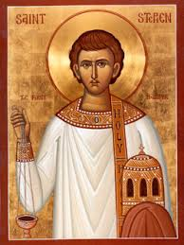
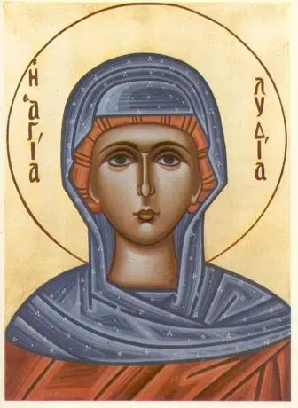
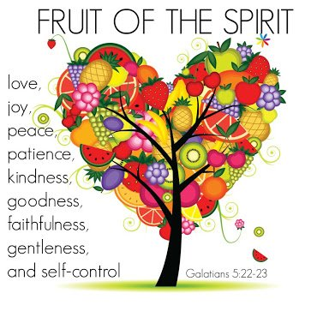
Year 6 Topic 7: Witnesses
Pentecost: The Holy Spirit enables people to become witnesses
Big Questions
What do I want to witness to in my life?
How do you know when to speak out?
Key Scripture
Acts 2:14, 32,33
Peter standing with the eleven, raised his voice and addressed them: ‘Men of Judea and all who live in Jerusalem let this be known to you and listen to what I say. This Jesus God raised up, and of that all of us are witnesses.
Learn and Grow Together in Christ
What I should know already
Pentecost is the celebration of the Holy Spirit’s transforming power
Key Vocabulary
Holy Spirit | The Holy Spirit is God, as is the father, and as is the Son. Nobody has seen the Holy Spirit, but we can see the works of the Holy Spirit through the joy, courage and strength that he gives.
Witnesses | A person who has seen an event.
Martyrs | Someone in the Christian faith who has died for their belief.
Good News | In the Bible, the Good News is the news of Jesus’ resurrection.
Inspiration | A person or event which influences someone to do something
Courage | The ability to face fear or danger.
Truth | Agreement with the facts of what is real
Jesus’ appearance to his disciples after his Resurrection – and disciples as a witness to the Easter message
Sticky Knowledge
Stephen was chosen to spread the word
by his service
The Ascension of Jesus and his promise to send the Holy Spirit
Witnesses to the Easter message: Lydia
Modern witnesses
to the power of
the Holy Spirit
Ourselves as
witnesses

