Slide 1

Supporting Children’s Learning at Home

Slide 2
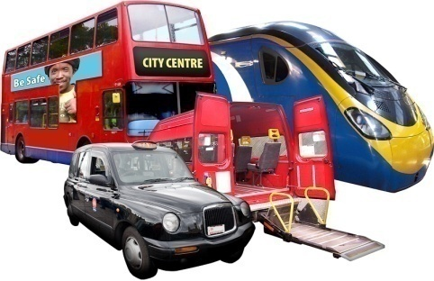

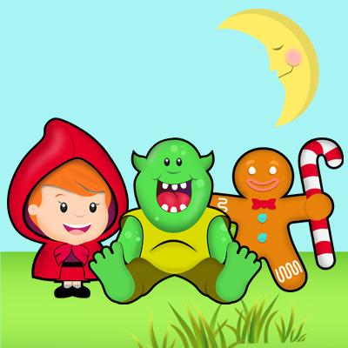
Class Themes
Ourselves
Celebrations
We love Stories
Bears
Growth
When I grow up
Each half term a home learning pic and mix
Notes:
Start each theme with a topic web

Slide 3
We follow the Foundation Stage Curriculum in Reception which is made up of 7 areas
Personal, Social and Emotional Development
Literacy
Communication and Language
Mathematics
Understanding the World
Physical Development
Expressive Arts and Design
Notes:
Play based, free choice and structured activities, small and large group work.

Slide 4
Examples of End of Year Achievements
To listen attentively and respond to what they hear
Participate in small group, class and one-to-one discussions
Demonstrate strength, balance, coordination when playing
Hold a pencil effectively in preparation for fluent writing
Begin to show accuracy and care when drawing
Be confident to try new activities and show independence, resilience and perseverance in the face of challenge
Explain the reasons for rules, and know right and wrong
Work and play cooperatively and take turns with others
Demonstrate an understanding of what has been read to them
Read aloud simple sentences and books that are consistent with their phonic knowledge, including some common exception words
Write simple phrases and sentences that can be read by others
Have a deep understanding of number to 10
Recall number bonds to 5, and some number bonds to 10
Explore and represent patterns within numbers up to 10
Know some similarities and differences between things in the past and now
Explore the natural world around them, making observations and drawing pictures of animals and plants
Sing a range of well-known nursery rhymes and songs

Slide 5
Talking
Building vocabulary and speaking skills is key to all aspects of children’s development
Talk with your child all the time- on the way home, during meal times, when out and about
Comment on the things they see and encounter
Play word games – how many colours can you name, things you would find at..
Read together talk about any new words in stories
Play games
https://home.oxfordowl.co.uk/building-a-strong-vocabulary-how-to-help-at-home/

Slide 6
Phonics
Phonics is a method of teaching children how spoken words are composed of sounds called phonemes and how the letters in words correspond to those phonemes. The process of reading involves decoding or 'breaking' words into separate phonemes, so that meaning can be gained

Slide 7
Phonics at St Mary’s
We follow Red Rose Phonics
We have a daily taught phonics session
Recap what has been learnt
Teaching of a new sound
Time to blend ( read) or segment (spell with new sound)
Use new skills- in groups games, 1-1 with and adult and in continuous provisions
home/https://home.oxfordowl.co.uk/building-a-strong-vocabulary-how-to-help-at-home/

Slide 8
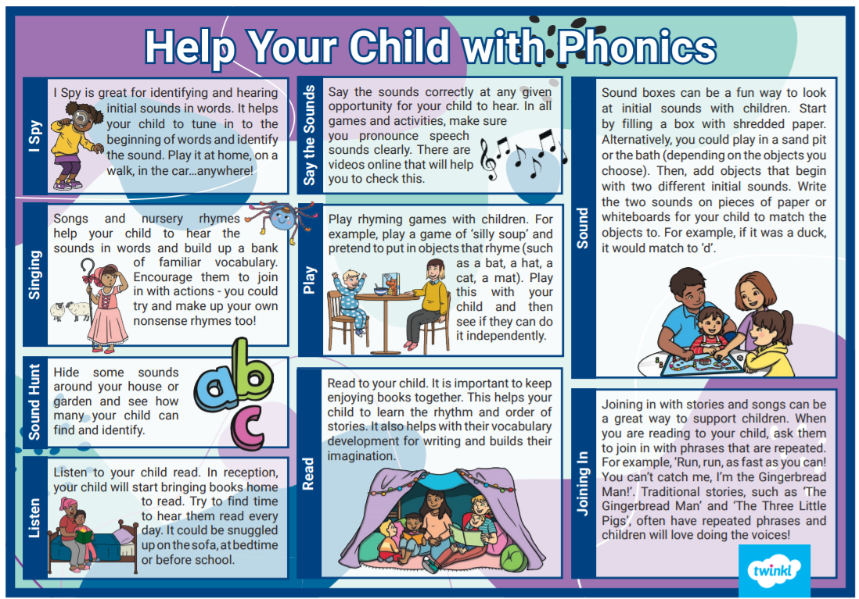
Phonics games to play at home

Slide 9

Reading
We read in school everyday
We read as a class, in small groups and 1-1
All books and words children read are linked to the phonics they have been learning
The children blend and read tricky words
What home reading looks like
Look at cover and talk about the book- Read the sounds and the tricky words at the start of the book- Encourage your child to read the sounds and blend to read the words- read smooth with your child
Please read at home every night
Please make sure you do read the reading books with your child as reading is such an important skill which helps develop your child’s understanding in all other subject areas.

Slide 10


Homework
Sound that the children have learnt
Words to blend
Tricky words which can not be blended
A tricky word is a word which cannot be sounded out, but one they need to remember, e.g. the, go, no.
https://www.youtube.com/watch?v=TvMyssfAUx0
Reading books ( each day then on the day written in the sticker on the book)
Each half term a Pic and Mix home learning sheet
Notes:
Key words – practise at home, children not to write in homework diary. Guided reading activity

Slide 11
E-safety
Please be aware of what your child is looking at online and what games they are playing.
Try to limit the amount of time spent on IPads, computers etc.

Slide 12
Finally, if you ever have any worries or concerns, please come and speak to us.

Slide 13


